Slide 1
Data Communication
MODULE I

Slide 2
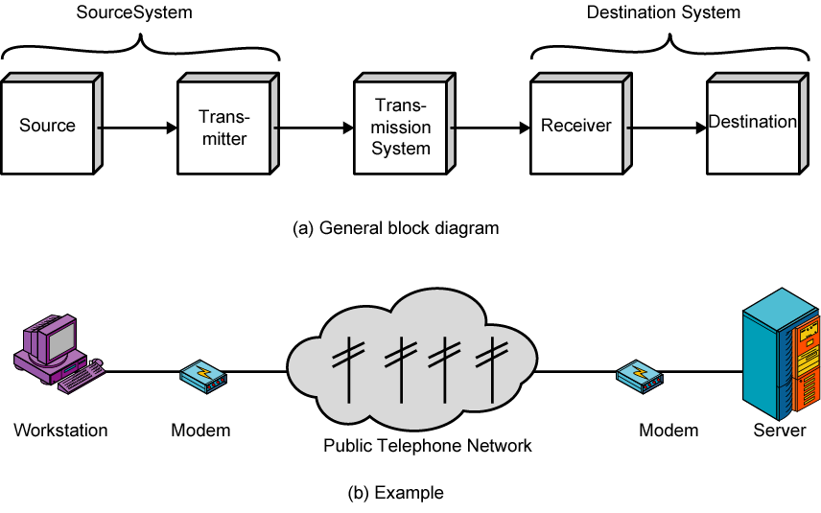
Data Communication Model

Slide 3
Data Representation
Data can be of different forms:
Text
In data communication, text is a sequence of 0’s and 1’s which can be represented using various codes
E.g Unicode(32-bit code)
ASCII(7-bit code)
(American Standard Code for Information Interchange)
Numbers
Represented by bit patterns
Numbers are directly converted to a binary number
Several numbering systems are available:decimal,binary,hexadecimal etc.

Slide 4
Data Representation
Images
Images are also represented by bit patterns.
Image is composed of matrix of pixels.
Each pixel is assigned a bit value.
For black and white image one bit is sufficient
For gray scale image more bit patterns are needed.
For color image RGB pattern can be used.
Audio
May be sound or music.
Different from image ,text or numbers.
It is continuous ,not discrete.
Microphone change voice or music to an electrical signal which is continuous.

Slide 6
Communication tasks
Transmission System utilization
Efficient use of transmission facilities that are shared among a number of communicating devices.
Techniques like Multiplexing is used to allocate the total capacity of a transmission medium among a number of users.
Congestion control techniques are required to assure that the system is not overwhelmed by excessive demand for transmission services.
Interfacing
To communicate, a device must interface with the transmission system
The data are communicated as electromagnetic waves propagated over the transmission medium.
Signal Generation
Once the interface is established ,signals has to be generated.
Properties of signals such as form and intensity must be such that the signal is:
Capable of being propagated through the transmission system
Interpretable as data at the receiver

Slide 7
Communication tasks
Synchronization
The signals are generated based on the transmission media and receiver.
There must be some form of synchronization between transmitter and receiver.
The receiver must be able to determine when a signal begins to arrive and when it ends.
It must also know the duration of each signal
Exchange Management
In telephone conversation ,the caller dial the number of other which results in ringing of phone in the called side.
Connection is completed when the called party lift the phone.
In data processing devices, connection establishment is required.
Along with that it has to decide whether both devices transmit simultaneously, or must take turns, the amount of data sent at one time, the format of the data and what to do if certain contingencies such as error arise

Slide 8
Communication tasks
Error Detection and Correction
In all communication system there is a high potential for error i.e. the transmitted signal get distorted to some extent before reaching their destination.
Error detection and correction is required where errors cannot be tolerated.
Usually needed in data processing.
E.g. File transfer
Flow Control
Flow control is required to assure that the source does not overwhelm the destination by sending data faster than they can be processed and absorbed.

Slide 9
Communication tasks
Addressing and Routing
When more than two devices share a transmission facility ,a source system must indicate the identity of the intended system .
The transmission system must assure that only the destination system receives the data.
Various paths may be available to the destination and a specific path must be chosen.
Recovery
Recovery techniques are needed in situations in which an information exchange ,such as a database transaction or file transfer ,is interrupted due to fault somewhere in the system.
The objective is either to resume activity at the point of interruption or restore the state of the systems involved to the condition prior to the beginning of the exchange.

Slide 10
Communication tasks
Message Formatting
An agreement has to be made between the parties as to the form of the data to be exchanged or transmitted ,such as binary code for characters.
Security
The sender of data may wish to be assured that only the intended receiver actually receives the data.
And the receiver of data may wish to be assured that the received data have not be altered in transit and that the data actually come from the trusted senders.
Network management
Data communication system is a complex system that cannot create or run itself.
Network management capabilities are needed to configure the system, monitor its status, react to failures and overloads and plan intelligently for future growth.

Slide 11
Data Communication Model

Slide 12
Data Communication Model
Suppose the source and transmitter be the components of a personal computer.
The user of the PC wishes to send a message m to another user.
Activate the email and type the message.
The message is buffered in memory as a sequence of bits ,g.
The PC is connected to some transmission media, such as a telephone line or a LAN using a modem or a local network transceiver.
The input data is transmitted to the transceiver as a sequence of voltage shifts , g(t).
The transmitter is directly connected to the transmission media and it converts the incoming data stream into signal ,s(t) suitable for transmission

Slide 13
Data Communication Model
But the signal s(t) presented to the medium is subject to various impairments before it reaches the receiver.
Thus the received signal r(t) received by receiver may differ from s(t).
The receiver will attempt to estimate the original s(t),based on r(t) and its knowledge about the medium producing a sequence of bits g‘(t).
These bits are sent to the output personal computer and it is stored in memory as g‘.
Destination system will attempt to determine if an error occurred and try to correct it .
This data is presented to the user via an output device,like printer or screen.
The message m’ will be the exact copy of message m

Slide 14
Concepts and Terminology
Transmission Terminology
Data transmission occurs between transmitter and receiver over some transmission media.
Transmission media can be classified as:
Guided media
Unguided media
In both cases the communication is in the form of electromagnetic waves

Slide 15
Concepts and Terminology
Guided media
The waves are guided along a physical path.
E.g. Coaxial cable, Twisted Pair, Optical fiber.
Unguided media
Also called wireless media.
It provides a means for transmitting electromagnetic waves but do not guide them.
E.g. propagation through air,vaccum or sea water

Slide 16
Concepts and Terminology
Transmission media can again classified as:
Direct link
Refers to the transmission path between two devices in which signals propagate directly from transmitter to receiver with no intermediate devices, other than amplifiers or repeaters that are used to increase signal strength.
Point-to-point
A guided transmission media is said to be point to point if it provides a direct link between two devices and those are the only devices sharing the medium
Multipoint
A guided transmission media is multipoint if it is shared by more than two devices.

Slide 17
Transmission modes
Transmissions may be:
Simplex
Half-duplex
Full-duplex

Slide 18
Transmission modes
Simplex
In simplex mode,the communication is unidirectional as an one-way street.
Only one of the devices on the link can transmit,the other can only receive .
Keyboards ,traditional monitors,printers etc are some of the simplex devices.
Keyboard can only introduce input and monitor can accept only output.
The simplex mode can use the entire capacity of the channel to send data in one direction.
Another e.g. is Television Broadcasting.

Slide 19
Transmission modes
Half-duplex
It is like a one-lane road with traffic allowed in both directions,but not simultaneously.
When vehicles are travelling in on direction ,vehicles going the other way must wait.
In a half-duplex transmission,the entire capacity of the channel is taken over by whichever of the two devices is transmitting at that time.
E.g. Walkie-Talkie

Slide 20
Transmission modes
Full-duplex
In full-duplex mode ,both sections can transmit and receive simultaneously.
Full-duplex mode is like two –way street with traffic flowing in both directions at the same time.
The signals going in one direction share the capacity of the link with signals going in other direction.
This sharing can occur in two ways:
Either the link must contain two physically separate transmission paths ,one for sending and other for receiving
The capacity of channel is divided between signals travelling in both directions.

Slide 21
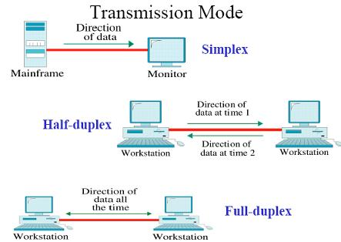
TRANSMISSION MODES

